Slide 1

Resilient Messaging…
How hard can it be?
Jon Rumsey (jrumsey@uk.ibm.com)
Distributed Queue Manager Architect – IBM MQ
October 22nd 2026

Slide 2

What is Resilient Messaging?
Dictionary definition of ‘resilient’
  Able to bounce back, recovery quickly from tough times, or return to an original shape after being stretched or bent.
MQ naturally deals with service outage and absorbs workload spikes
There is no “Gold Standard”, every application is different
Notes:
Message queues provide a natural resiliency to cope with fluctuating workload levels and service outages.
Assured messaging provides once and once only delivery, ensuring no message loss or duplication.
In many cases resiliency requirements will vary from application to application.
Not every application will need or benefit from the “Gold standard”

Slide 3
Building Resiliency
Resilient messaging is achieved not just through exploiting advanced product features
The basic choices messaging architects, application developers, admin and operations teams make every day are critical
A “Failure” anywhere in the stack impacts the whole system
Never assume that “Everything will succeed all the time…”
Storage
Queue
App
App
App
Queue
Queue
Notes:
Resiliency is often discussed as being as simple as enabling a product feature, it isn’t.
One weak link is enough to undermine the whole system.
True resiliency can only be achieved through considering this a full-stack concern.
If an application makes a poor choice, bulletproof reliability of hardware or the queue manager can’t save it.
Resiliency is a shared and compound responsibility, architects make choices, developers make choices and ops teams make choices.
When an unplanned outage occurs (and it will occur) if it is not handled it could have a significant business impact.

Slide 4
Resiliency choices
The decisions of the architect, developers and ops teams are many and just as critical as the reliability of a disk
  Does a message need to survive a resource outage?
  Does a message have a “shelf life” ?
  What if the outage is unplanned? Multiple resources?
  What if the outage is site-wide? Region-wide? Permanent?
  Under exceptional circumstances, is data loss acceptable?
  What are the acceptable recovery times? For the service? For the message?
  Consistency and message sequencing requirements?
  Performance and scalability?
  Capacity? Queue depths? How long will transactions run?
  Cyber-attack and security?
  What level of redundancy is needed?
Notes:
Before we talk about the technology, let’s think about some of the decisions we need to make.
Whilst most decisions will be binary, decisions will rarely be “no-brainers”, there are always trade-offs.
Setting a goal of handling unplanned failures and minimizing downtime, message loss and cost is of course for most applications a given.
But different applications may have radically different criteria for what is acceptable.
Understanding these requirements before deploying the application is a must.
Requirements can change too, review regularly and prepare to be flexible.

Slide 5
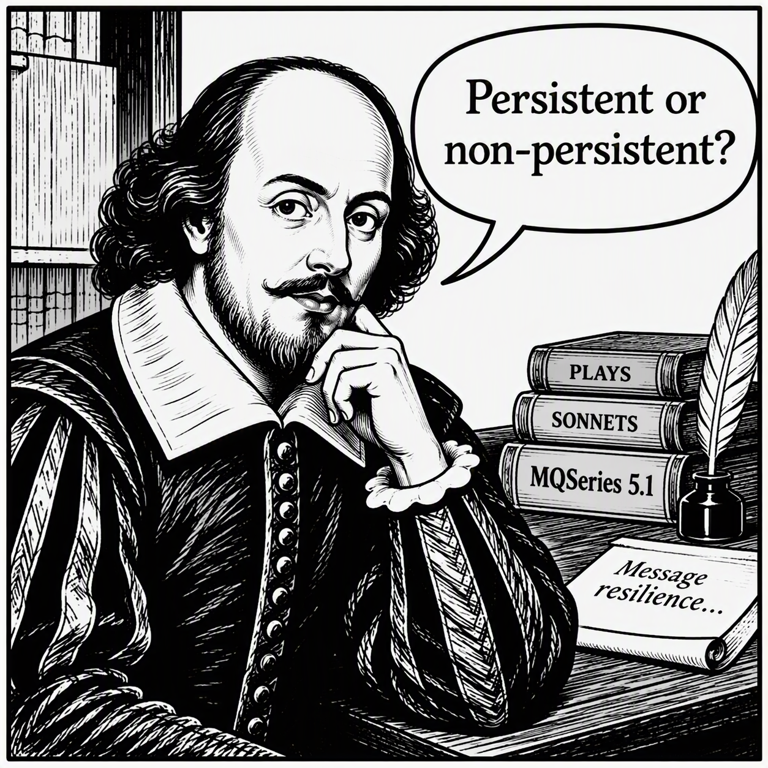
To be… Or not to be
Persistent or non-persistent
To be, or not to be, that is the question:
Whether 'tis nobler in the mind to suffer
The slings and arrows of outrageous fortune,
Or to take arms against a sea of troubles
William Shakespeare – Hamlet (1603)
The existential decision for Bill the sabre-toothed application developer is …
Notes:
Can you have resilient non-persistent messaging?
Yes, but it depends whether losing a message matters to the application.
Stateless request-reply applications may not require any persistence e.g. Query the current inventory levels for widget X
Whilst message availability cannot be improved for a non-persistent message*, service availability still can
e.g. If QM1 is unavailable, try QM2

Slide 6

Transactions
The choice of whether an application needs to use a transaction is a similar binary decision
  Transactions can simplify application logic
  Transactions ensure
    Everything succeeded, or
    Everything failed,
    …or sometimes your application doesn’t care
Information about each transaction is recorded by a queue manager into the recovery log
  Transactions can also have a side-benefit of making disk writes more efficient
Notes:
Transactions also improve the efficiency and performance of applications in reducing the frequency and number of forced disk writes that are necessary.
Applications that involve just MQ activity might choose a single-phase commit.
Applications that involve other transactional resources such as a database table update might choose two-phase commit.

Slide 7
Resilient Applications
Messages spring into existence and cease to exist in the application.
Consider the pseudo-code for a simple IBM MQ messaging request application:
  MQCONN(“QM1”, &hqm, &cc, &rc);
  …
  MQOPEN(hqm, “Q1”, &hobj, &cc, &rc);
  MQOPEN(hqm, “Q2”, &hobj2, &cc, &rc);
  MQPUT(hqm, hobj, MQPMO_NO_SYNCPOINT, …, &cc, &rc);
  MQGET(hqm, hobj2, MQGMO_WAIT, …, &cc, &rc);
  …
  MQDISC(&hqm, &cc, &rc);
6 lines of application logic that demonstrate how …not to write… a messaging application!
Don’t just take sample applications as templates for how to write a ‘good’ application.
Notes:
Lack of error handling on each call.
Lack of retry logic for recoverable errors (e.g. queue full).
Hardcoded names make it difficult to improve service availability.
Lack of explicit definition of message persistence could lead to lost messages – “as queue def” has a time and a place but most applications should assert the persistence they need.
Lack of a transaction could lead to lost or duplicated requests.
Lack of fail if quiescing options could lead to delays.
Lack of explicit close of queue handle could lead to resource problems.
Reliance on default options keeps code neater but lacks expression of intent (and no comments to indicate what those were!).
Well-written messaging applications can exploit resilient architectures, whilst a poorly-written application can undermine all other provisions to improve it.

Slide 8
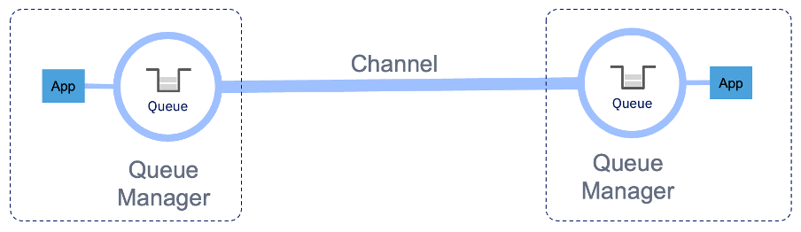
Does non-persistent mean non-resilient?
Queue managers can be linked together to form networks
  Simple point-to-point or more complex clusters
  Channels provide the transfer of messages over networks
  Message Channel Agents in IBM MQ are just two applications working together to move messages from A to B
    Transactional
      MQGET batch of messages from a transmission queue
      MQPUT to target queues on the target queue manager
    Retries for temporal issues
      Network down, queue full, etc
Notes:
Message Channel Agents are an example of messaging applications too.
Channels play by the same rules as a standard application using MQGET and transactions to move messages from one queue manager to another.
Positive receipt of a batch of messages allows the sending and receiving MCA to commit its transaction.
Question – can an application that just handles non-persistent messages be considered resilient?
Perhaps – a transfer of non-persistent messages over a channel is a good example that certain types of outage (e.g. network blip) are recoverable without data loss.
Message retry could be used to handle target queues being full.

Slide 9
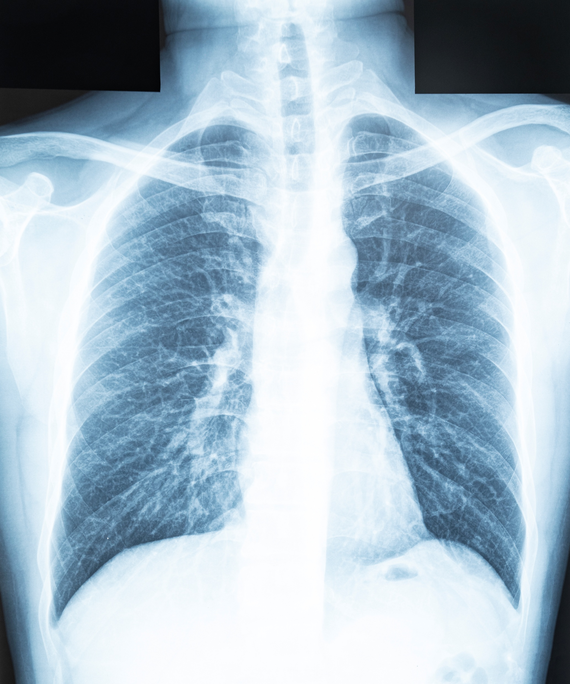
MQ Anatomy 101

Slide 10
Recovery Log & Queue Files
App
A recovery log provides MQ with assured messaging and crash recovery, solving similar problems to that faced by databases for crash recovery
  Write-ahead of queue files
  Recovery log used by IBM MQ distributed platform shares an ancestry with the logger used by DB2
Choices of recovery log types
  Circular
  Linear
  Replicated
Queue Manager
Logs
Queue Files
Notes:
There are multiple components that provide the persistence layer for a queue manager.
We will look at the recovery logs and queue files.
The recovery log is either circular or linear. The main difference is that media recovery information can be recorded alongside the messaging and transaction data.
A replicated log is a specialized form of linear log that is used by Native HA that provides distributed replication instead of relying on storage performing this task.

Slide 11
The Recovery Log
The recovery log is the master record of everything that MUST be recoverable
  Persistent messages, transactions, queue creation, alteration, deletion
  Non-persistent message data is NOT written to the recovery log
  Log data is written in multiples of disk pages (typically 4KB) to fixed size extent files
  The tail of the log may contain log data that doesn’t fill a whole page, known as a partial page
  Each page carries a checksum that can be used to check integrity of the log
  Active log tracks current transactions
  Linear and replicated log types retain older log extents containing media images
  Log is only read when performing crash or media recovery
Notes:
I am immensely biased of course, but I would argue that the recovery log is the most fundamentally important component of IBM MQ.
When you think about messaging resilience, achieved through persistence and transactions, you may be forgiven in thinking this is provided by the queue.
We will go onto talk briefly about how queues act as a working copy of message state (both persistent and non-persistent) whilst the sun is shining and the power is on.
The recovery log is always there, keeping track of the queue managers commitments to applications.

Slide 12
The Queue File
A queue file is used to store a ‘working copy’ of a queue and its messages on disk
  Creation, alteration and deletion of queue files is persisted in the recovery log
  Message contents of a queue are loaded from disk into memory when a queue is first opened
    In memory buffers provide fast read/write access to messages
  Queue is updated on disk when necessary
    Both persistent and non-persistent data
    Writes to the queue file are buffered
    But… the recovery log remains the master copy of everything that must be recoverable
Notes:
Every hero needs a sidekick!
The recovery log works in close cooperation with the queue file to provide fast and reliable access to message data.
The queue file provides a convenient way of accessing messages on persistent storage.
Loaded into memory and flushed out to disk when necessary.
Unlike the recovery log, the queue file could contain both persistent and non-persistent message data.

Slide 13
Redo, Undo and Checkpoints
Log replay
  Fundamental to ensure data integrity and transactional consistency
  A queue manager must perform crash recovery whenever it restarts
  Any disk writes to queues that may have been interrupted are reconciled (Redo)
  Unprepared transactions that were in-flight are rolled back (Undo)
Checkpoint is recorded frequently
  A checkpoint is a progress marker in the recovery log
  Checkpoint determines where in the log crash recovery needs to start
Notes:
Whilst MQ writes to the recovery log all the time, it is rare that log data will be read back again.
Simply put - A checkpoint is a progress marker in the recovery log that a queue file on disk is consistent with all previous logged operations.
The successful progress of each checkpoint is recorded in a checkpoint file, which avoids needing to search through the log to find it.
Checkpoint file is used to determine where in the log crash recovery needs to start.
On a lovely sunny day, when a queue manager quiesces – the last thing it writes to the log is a checkpoint.

Slide 14
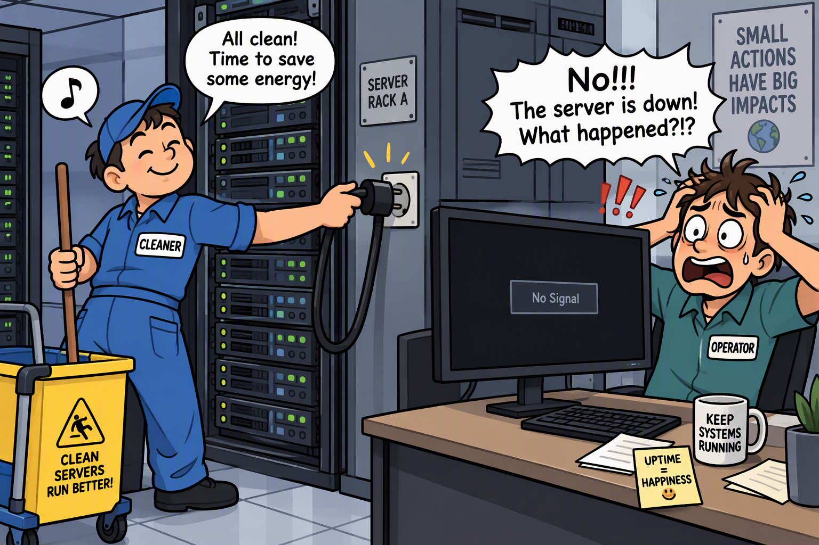
Assured messaging
For assured messaging, applications must only be told of success when operation is “crash-recoverable”
  For persistent messages or transactions this will involve a disk write to the recovery log
  For transactional writes (i.e. a put of a transactional persistent message) the write may be flushed asynchronously via the kernel from the OS page cache
  For non-transactional writes or transaction commit or rollback the write MUST be forced to disk (fsync), returning only when data is known to be on storage
If the system stops really abruptly
  In-progress writes to the disk (log and queue files) incomplete
  Dirty pages in the OS page cache are lost
Notes:
Assured messaging needs to provide reliable and resilient messaging come rain or shine.
Persistence for messages and transactions is provided by a combination of volatile and non-volatile storage
Queue buffers (Memory - Persistent & Non-persistent)
Recovery log (Disk)
Queue files (Disk)
We’ve introduced the basic architecture of how IBM MQ hardens any persistent data.
The recovery log records intent and enough information to redo messaging operations should there be an unexpected interruption.
But what happens in an unexpected system failure and how does IBM MQ use the recovery log?

Slide 15
Crash!
What could happen to a queue file in a crash?
  Maybe nothing bad
  But maybe the queue file only contains a partial update
  Replaying the recovery log will redo any incomplete writes
“The quick brow…”
“The quick brown fox jumped over the lazy dog”
Notes:
Various unplanned outages could impact a queue manager.
In some cases a crash may be relatively soft, in other cases it may be abrupt and unforgiving.
Killing a critical process may seem severe, but it would still allow page cache to flush to disk.
A loss of power is abrupt which could leave a ‘torn’ write. Modern hardware and filesystems provide mechanisms to protect against this, but…. Everything FAI….

Slide 16
Damaged queues
Log redo can correct an incomplete queue file write
A crash cannot damage or corrupt a queue
  However… everything fails (including redo?)
    If the disk or filesystem fail, or an operator or other third-party have deleted or replaced a queue file or log extents, there is no guarantee that log redo can correct
    The queue will be marked as damaged
    Messages cannot be accessed
    If using a log type that provides media recovery (Linear/Replicated) the queue can be recovered through a longer redo from the previous media image
    If using a circular log type, the queue can only be deleted and recreated
Notes:
Redo can recover only if the queue file on disk at restart represents a possible state at an instant in time since the last checkpoint was recorded.
Activity performed outside of the normal operation of a queue manager could lead to a failure of the log redo. Again remember, everything could fail and that includes redo.
The best example of an outside interaction is an accidental deletion of a queue file – “Ooops” but restoring a backup copy of a queue file might also lead to log redo detecting an inconsistency and marking the queue as damaged.

Slide 17
Crash!
What could happen to the recovery log in a crash?
  Maybe nothing bad
  But maybe the log now contains a partial update
  Safe to erase any incomplete log records from the tail of the log
    Log is write-ahead
  Partial page recovery (TripleWrite)
    If an existing partial page was being updated, a good copy of the page can be restored from the adjacent page
Msg#1
Msg#1
Msg#1
Msg#2
Msg#1
Msg#2
Msg#1
Msg#2
Notes:
Log is write-ahead so it is safe to erase any incomplete log record as we could have never guaranteed this as a forced write
Triple write only applies to updating partial pages
… no, it doesn’t mean we are writing the same log data 3 times
1st) The original partial page is written with space for further data
2nd) Write desired update partial page in next adjacent page
3rd) Overwrite the partial page with the new content

Slide 18
Log page recovery
The recovery log is our resilient superhero for recovery of queue files
  Can recover itself…
But… Everything fails!
  What if?
    A whole log extent was corrupted, truncated or deleted
    A disk volume has been lost
    We need recovery for the recovery log!!!
    We don’t just need a superhero, we need a team of superheroes!
Notes:
Up until now, the recovery log has been our everyday superhero.
The problem is sometimes superheroes can have a bad day at the office.
What happens if the recovery log is unavailable?
What happens if the filesystem is corrupted? The storage volume disappears?
Someone accidentally deletes something they didn’t mean to?
The recovery log protects the queue files, but who protects the recovery log?
This is where we have to look at other techniques for improving availability – like replication. We have to assemble a team of superheroes.
We will look at whether that could be a dynamic duo? Or a triple threat?

Slide 19

Improving Availability

Slide 20
Availability
The recovery log and queue files provide the basics for message resilience
  A single queue manager on reliable infrastructure is pretty resilient
But… Everything fails!
Some applications would benefit from higher levels of data availability
  The strategies for improving message and service availability have shifted over the last 30 years
Notes:
As we see the basic product features make message queuing resilient without needing to exploit “advanced” availability features.
But as we know, assuming success all of the time is foolish.
Some applications need higher levels of availability – particularly ones where messages have a “shelf life”.

Slide 21
Big in the ‘90s
Jurassic Park, X-Files, Nirvana & Pearl Jam, Oasis & Blur
‘Pet’ Queue Managers
  Mission critical monolithic wonders
  Typically hosted on dedicated ‘bare-metal’ servers with pet hostnames
  Located on premise in own datacenter
  Optional 2nd datacenter close-by for HA using mirrored resources
  Dedicated middleware teams
  “Uptime boasting” – Infrastructure always ON
  Infrequent version upgrades (Quarterly/Yearly)
  Vertical Scaling
  Hosting queues for multiple applications
Notes:
Ah, the wonderous days of the 1990’s when big queue managers ruled the earth…

Slide 22
What’s big today
Oasis?
Herds of ‘Cattle’ Queue Managers
  Smaller queue manager - Microservices
  Hosted on ‘Pay-as-you-go’ (IaaS, PaaS, SaaS) or ‘On-prem’ infrastructure
  Physical hosts typically virtualized or containerized
  Multi-skilled DevOps engineers
  Continuous monitoring
  Dynamically and horizontally scalable
  Frequent and potentially unpredictable security patching schedules
  Greater demand for 24/7/365 availability
  Service remains always ON across multiple availability zones
Notes:
Today scalability, availability and resilience are typically achieved horizontally rather than vertically.
Host and queue manager names tend to have names that are a seemingly random combination of droid designations.
Demand for availability and an always on service is greater than before.

Slide 23
Measuring Resiliency
SLO Service Level Objective
  The target for how available a service is
  Expressed as a percentage (e.g. 99.999% approx 5 mins downtime per year)
  SLI Service Level Indicator is a direct measure of achieved service level
RPO Recovery Point Objective
  The target for how much data could be lost during recovery
  May be different for planned vs unplanned outage
  May be different for persistent and non-persistent data
  RPA Recovery Point Actual is a direct measure of how much data was lost
RTO Recovery Time Objective
  The target for how quickly the recovery should take
  This can be critical for some applications, restoring access to consumers to queues with unprocessed messages
  RTA Recovery Time Actual is a direct measure of how quickly availability was restored
Notes:
How do we measure resilience?
Lots of different ways and scales.
Availability is usually based on percentages, typically over a long period of time (e.g. year).
Recovery point is a measure of how much data and can be based on different scales, e.g. bytes, messages, transactions, etc.
Recovery time is a measure of how quickly recovery is achieved.

Slide 24

Catching a train
Popular commuter routes will offer multiple rail services, particularly during peak times
Some services might be preferable over others (express, less crowded, buffet car, etc)
But much of a muchness
Sometimes planned service outages might affect your choices and so be prepared to use a different service
  Planned engineering work
You hope it doesn’t, but… everything fails unexpectedly
  Signal failure, driver sick, mechanical breakdown, train full, too many leaves on the line, …
If a train is cancelled before you board, you could still seek an alternative service
  But - if you are already on the train, you (and all the other passengers on the same train) are going to need to wait
Notes:
An analogy that many of us can relate to in terms of dealing with a change in availability is transport.
In rush-hour there might be several trains that could take you to your destination, you might choose the closest platform.
One simple way to improve service availability is to have more trains, if one train is delayed or cancelled you could board another.
Maybe it doesn’t matter if your train is a few minutes slower than another service?
What happens if you board a train and there is a breakdown between stations? You cannot progress towards your destination until your train is able to continue.
This is similar to a message being on a queue, the availability of the message depends on the queue being available, which depends on the queue manager being available, which depends on…
Improving message availability requires a different approach to providing service availability.

Slide 25
Service vs Message Availability
queue manager
Queues provide asynchronous messaging
  Service Availability
  An application that can access a queue to exchange messages with other applications is considered to have service availability.
  Message Availability
  Once a message is on a queue, the continued availability of that specific queue for consumers leads to the concept of message availability.
queue manager
queue manager
queue manager
queue manager
Notes:
Improved service availability is typically achieved through active/active topologies, the simplest example is two queue managers.
A message stored on a queue only has value if a consumer can get it. Some messages may cease to be valuable after an elapsed period of time.
Some applications may require just high service availability, high message availability or sometimes both!

Slide 26



Tandem skydiving from 15,000ft
60 seconds of freefall
  Reach terminal velocity of 125mph (200km/h)
Parachute deploys at 5,000ft, 4G+ of deceleration force
  5 minutes of gentle parachute gliding back to earth
Exceptionally high standards of engineering in design, manufacture and maintenance of all equipment
  Highly experienced instructors
You really hope it doesn’t, but… everything fails
  Aircraft mechanical failure, Canopy fails to open, Instructor passes out, Mid-air collision, Misjudged altimeter, …
Redundancy becomes interesting
  Recovery time also becomes VERY interesting too!!!
2nd Reserve parachute provides redundancy
  Parachutes contain automatic activation devices
But sometimes you can’t mitigate against ALL eventualities (i.e. bad landing)
Notes:
Tandem instructors will be experienced and have hundreds if not thousands of jumps.
The most expensive part of a parachute is the automatic activation device that deploys if speed and altitude are too low.
Redundancy for certain applications isn’t a frivolous optional extra but an absolute necessity.
Recovery time for certain applications is hugely critical. In 30 seconds time a message may have no value. In 30 seconds time a terminal velocity may take on two definitions!
Even through careful planning, preparation and investment you may not be able to prevent a failure.

Slide 27
Redundancy
Active/Active topology is relatively easy to achieve with MQ
  Just… add more queue managers with separate queues
    Provides redundancy and horizontal scaling
  But… brings new complexity
    Connection and workload balancing
    Message ordering
    Doesn’t prevent messages being stuck
Not even 100 queue managers will improve message availability
  QM1 crashes with 100,000 messages
  Message availability for a single queue manager can be improved
    Resource redundancy and reduce recovery times
Notes:
A common assumption is that more queue managers gives you active/active topology which is more resilient.
This is not always true.
Adding queue managers is like putting on extra trains during rush hour, it improves availability and it can improve scalability.
But - it doesn’t solve the problem of message availability, the message sitting on a queue of an inactive queue manager is still stuck there, like the unfortunate commuter on the train carriage.
Brings its own set of problems, addressing multiple queue managers, efficient balancing of workload, message ordering, …
If your application needs to ensure messages are processed within a specific time, message availability is critical. Recovery time is critical.
High availability architectures can improve service availability, message availability or combined to improve both.
And should HA fail, you should be able to answer the question of what you will do to recover – because as we know. EVERYTHING FAILS (yes - even HA fails).

Slide 28
Storage Redundancy
Storage underpins queues
  Unavailable storage… means everything else is unavailable too!
Avoid a single disk drive being the only copy of data
  Storage layer
    Locally (i.e. RAID)
    Distributed (i.e. RDQM via DRBD)
  Native
    IBM MQ Native HA, CRR & IRR
Replication can provide greater resiliency
  Additional copies of data provides redundancy
  Catastrophic loss of a disk may no longer mean losing messages
  Of course, maintaining replicated data brings new problems to solve
App
App
App
Queue
Queue
Queue
Storage
Notes:
Lose your access to storage, lose your access to queues, lose your access to messages …
Storage redundancy provides one way of solving message availability
Can be provided at the storage layer or natively. The benefit of a native implementation is that the relationship between the queue files and recovery logs is understood.

Slide 29

Consistency and Availability
Imagine a queue manager replicated across datacenters
Network fails
Would you prefer to have
  Consistency?
  Availability?
  Both would be nice?
Notes:
This is one of my favourite questions!
The datacenters lose a network connection between each other and you can only choose one:
Preserve consistency
Preserve availability
Of course, having both would be nice but sometimes life is unfair.
Distributed systems don’t always give us that option and the way that different technologies answer this question tells you a lot about their design.

Slide 30
Brewer’s (CAP) theorem
Having your cake and eating it?
  Consistency and Availability during Network Partition?
  No. Sadly not…
  Network partitions are unavoidable
    So, do you prioritise consistency or service availability?
Network Partition
Service Availability
Data Consistency
Notes:
Computer scientist Eric Brewers theorem (http://www.ccs.neu.edu/groups/IEEE/ind-acad/brewer/sld009.htm) applies to the rules that govern what guarantees can be provided by a distributed data store.
Imagine an airline booking system with a server in North America and another in Europe.
If the servers cannot communicate, to survive network partition you would need to either sacrifice consistency (risk of double booking a seat) or availability (not permit any new bookings) until the network partition is resolved.

Slide 31
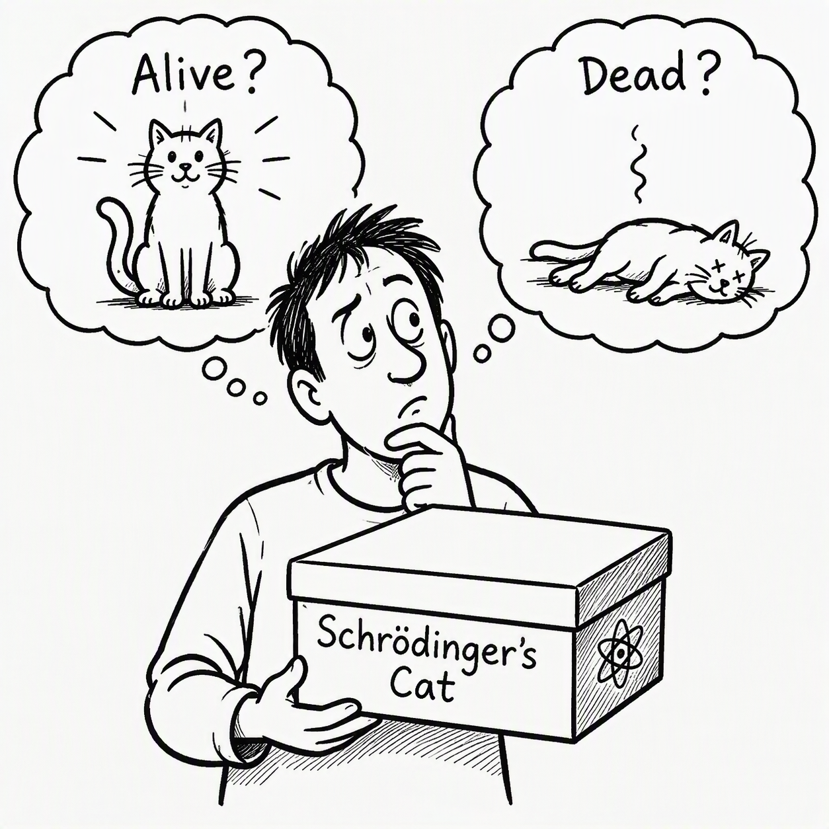
2 x Replicas
The simplest solution to provide distributed redundancy for storage is to maintain 2 copies
  Distributed copies of data in active/passive
  Natural topology across 2 datacenters
  To provide RPO zero, link must be synchronous
  If RPO > zero is acceptable, link could be asynchronous
But… Everything fails!
  What happens when the active is network partitioned?
    CAP Theorem
    Choosing to convert passive replica to active without knowing whether the replica is alive or dead risks loss of consistency… also known as “split-brain”
Notes:
2 replicas provides redundancy but provides its own problems.
If replicas lose connectivity, which replica is the source of truth?

Slide 32
Sacrifices
With 2 x Replicas, without being connected to the other one replica cannot safely…
  Promote itself from passive to active
  Progress new work
  Determine what difference(s) it has to the other replica
  Sacrifice consistency or availability
    Who should make that choice?
    Automatic?
    Perhaps not, sacrificing consistency of a queue would imply loss or duplication of messages
Notes:
The uncomfortable reality of distributed systems is that with 2 replicas, neither replica can ever have enough information to SAFELY make decisions by itself.
If communications are lost between replicas, each replica is left wondering whether the other replica is unavailable or just unreachable.
Making the wrong decision risks loss of consistency and a split-brain.
In messaging, a split-brain implies messages are either lost or duplicated.
For most (not all) messaging scenarios, consistency is not a sacrifice we would be willing to make.
The decision to pause rather than guess is the only reasonable default.

Slide 33

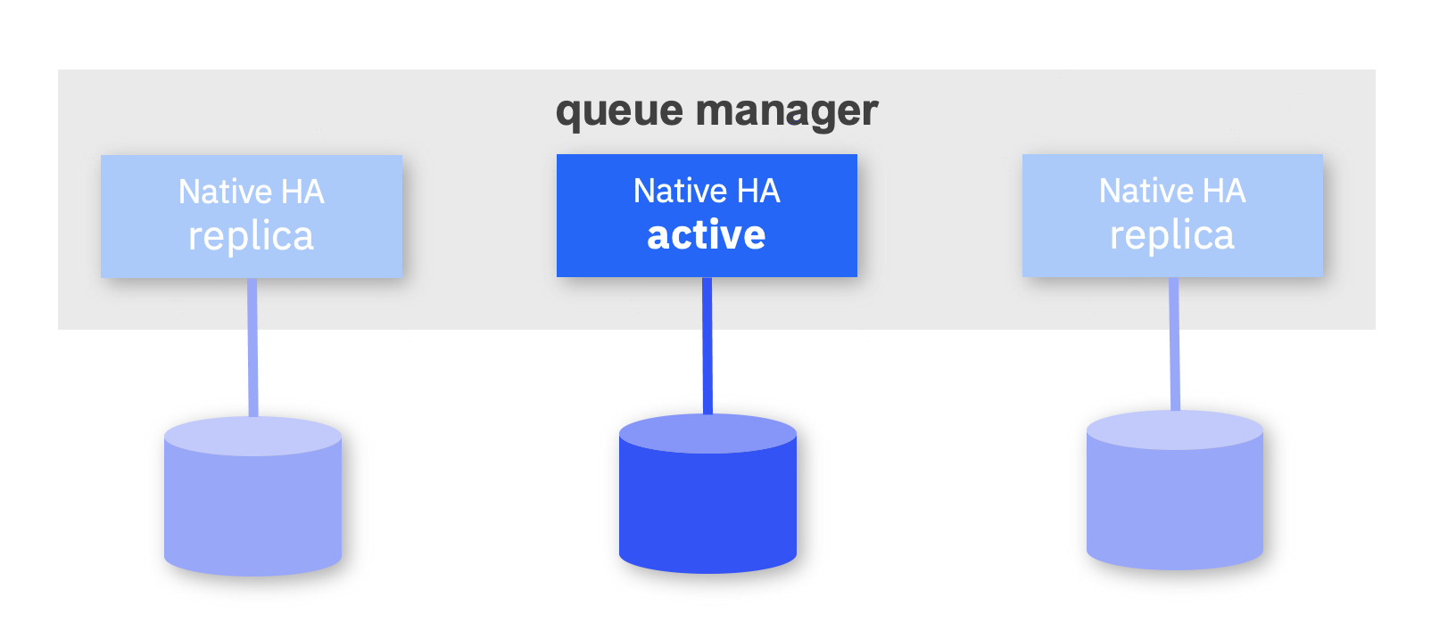
Jump on the raft!
More replicas can help
  Algorithms like Paxos and Raft can be used to implement distributed data consistency
  Some algorithms can be complex
  Raft was designed to be simple to understand
    Make decisions based on majority (quorum)
    Term elections are used to select strongest leader
    Only leaders author new log data and must continue to assert liveness
    Partitioning or loss of a minority does not impact availability
    IBM built raft into the recovery log for Native HA
      3 x Replicas
Notes:
Raft solves the problem with distributed consistency by adding a third opinion, essentially this allows arbitration where there is doubt.
https://raft.github.io/raft.pdf
A leader is elected, the leader is elected on the strength of the persisted data they hold.
CAP Theorem still applies!
No, this isn’t magic…
Provided a majority of the group remain connected, the system can continue (Consistent and Available).
This does however mean that a minority of the group could suffer a network partition or data loss.

Slide 34
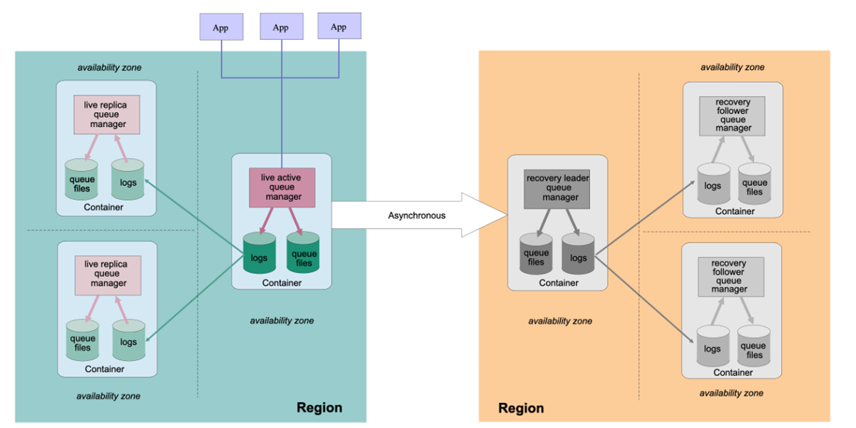
But what if… ?
A whole datacenter fails
  Unplanned event e.g. Power cut
A whole region fails or is about to fail
  Unplanned event e.g. Hurricane
  All the replicas are in the same region
Decide priority
  Wait until the storm blows over? (Consistency)
    Avoid split-brain but lose message availability
  Failover to a new region? (Availability)
    Laws of physics governs RPO
Notes:
Native HA is an example of a high availability solution with automatic failover within a region with RPO zero
But if an entire datacenter fails taking all or the majority of the replicas with it, what happens?
Similarly, if an entire region unexpectedly fails – do you wait or trigger a failover to a new region that cannot provide RPO zero?

Slide 35
Recap
Resiliency isn’t just a product feature or hardware
  Basic choices can be hugely important
  Persistence alone does not imply resiliency
Messaging outages are typically caused by one thing
  Assumption
Be prepared!
  Make choices before the failure occurs
Never forget…
  Nothing succeeds all of the time… everything fails
Notes:
The one takeaway I’d like everyone to remember is that resiliency isn’t a tick box exercise, you don’t achieve resiliency through a feature but through adopting a mindset.
Resiliency is achieved through making hundreds of choices.
Persistence, transactions, application design, Logging, storage, replication, redundancy and operational practices all contribute.
Technology is important but understanding the trade-offs is even more important.
And finally, one lesson that every engineer learns – everything fails.
The real important question is whether you have already prepared for that eventuality and how your plan holds up.

Slide 36
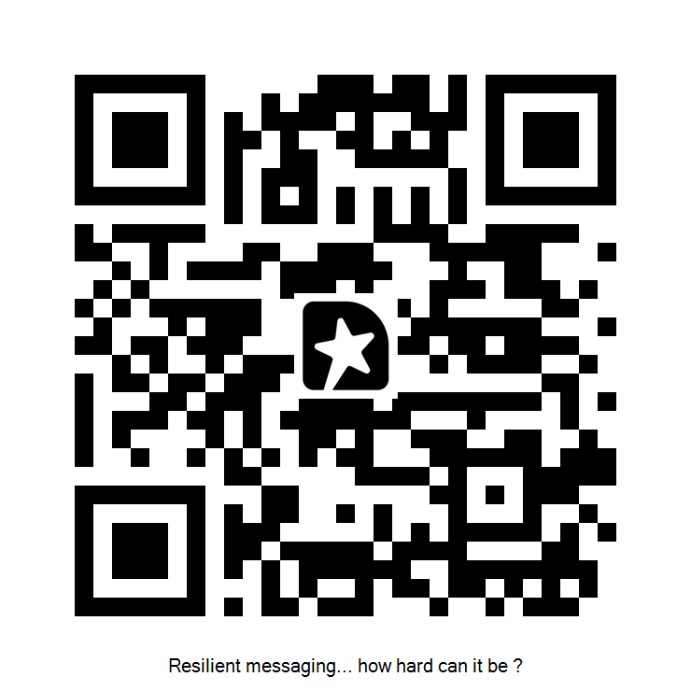
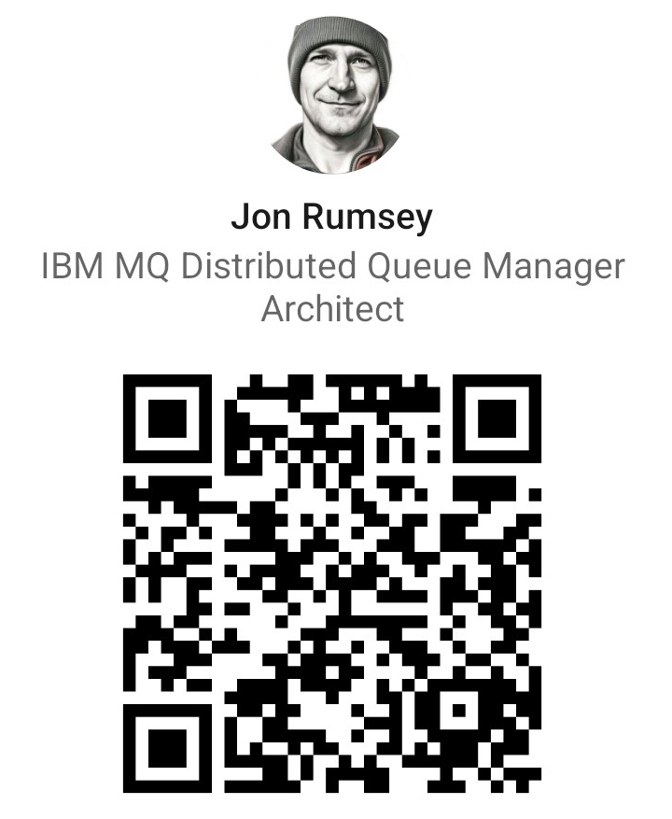
Questions?
THANK YOU!
www.linkedin.com/in/jonrumsey
jrumsey@uk.ibm.com
Notes:
Thank you – please feel free to leave session feedback and contact via LinkedIn

